Slide 2
Python Maths

Slide 3
Introduction to
Python Programming

Slide 4
Activity: Draw the Image
Draw a square.
Inside that square draw another 2 smaller squares.
Draw a triangle attached to the big square.
Finally inside the larger square draw a rectangle that touches the square.

Slide 5
What is Programming?
Programming is telling the computer what to do using a set of ordered instructions.
The set of ordered instructions is called an algorithm.
The language used to tell the computer what to do is called a programming language.

Slide 6
Lines of Symmetry

Slide 7
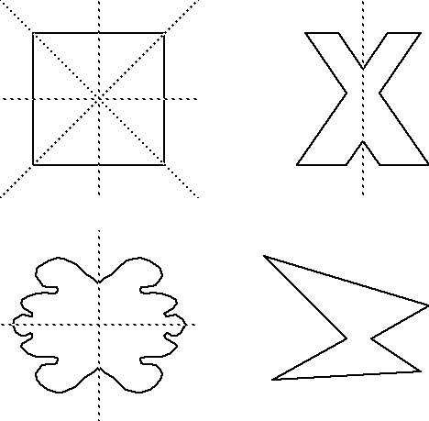
Lines of Symmetry
A 2D shape is symmetrical if a line can be drawn through it so that either side of the line looks exactly the same.
The line is called a line of symmetry.

Slide 8
Angles

Slide 9
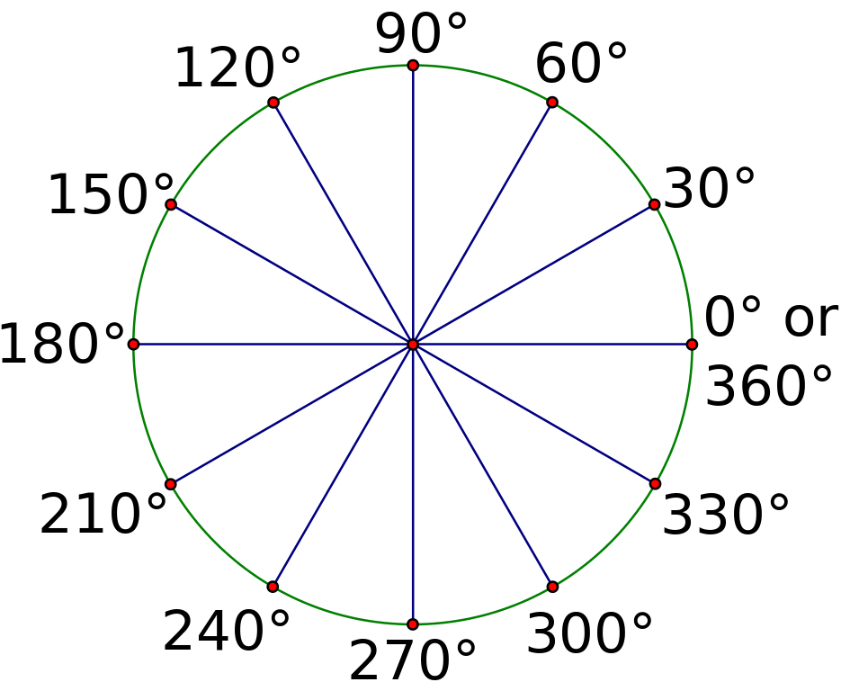
Angles
An angle is the amount of turn between two lines around their common point (the vertex).

Slide 10
Activity: Geometry
Identify the 2D shapes from the given properties:
2 sets of equal sides 4 equal angles (90°) 2 lines of symmetry
a) 4 equal sides b) 4 equal angles (90°) c) 4 lines of symmetry
3 equal sides 3 equal angles (60°)

Slide 11
Geometry in Programming
We already know that programming is telling the computer what to do.
We are going to tell the computer to draw us some 2D geometry shapes.
Computers will only do exactly what we instruct it to do.
Clear instructions are essential.

Slide 12
Activity: What is Python?

Slide 13
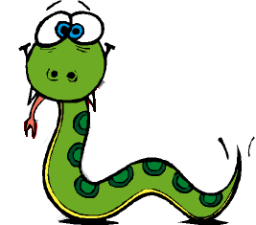
Python
It is neither a snake nor parseltongue from Harry Potter.
It is a programming language which tells the computer what to do using algorithms.
It is free.
It is easy to learn, read and code.
It is interactive and portable.
It is high level and flexible.
The author of the Python programming language is a Dutch man called Guido van Rossum, named it after his favourite TV series Monty Python’s Flying Circus

Slide 14
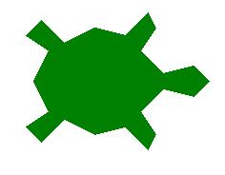
Turtle Graphics in Python
We will learn Python using Turtle.
Assuming that a turtle can understand simple commands, how can we make the turtle create some fun mathematical graphics (like geometrical shapes) using these commands?
Python has many libraries (set of commands).
Today, we will use Turtle Graphics to create 2D shapes.

Slide 15
Activity: Draw a Square
Let us assume that you are the turtle. You only understand two instructions.
forward x: You can only go forward x steps e.g. forward 100 (move 100 steps forward).
right y: You can only turn right (clockwise) at the given y angle e.g. right 90 (turn clockwise 90 degrees).
Write the instructions to draw a square using only those two instructions.

Slide 16


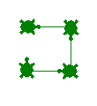

Square - Instructions
forward 100
right 90
forward 100
right 90
forward 100
right 90
forward 100
right 90

Slide 17
Square - The Turtle Way
forward 100
right 90
forward 100
right 90
forward 100
right 90
forward 100
right 90
forward (100)
right(90)
forward(100)
right(90)
forward (100)
right (90)
forward (100)
right( 90)

Slide 18
First Turtle Program
import turtle | Get the turtle commands

Slide 19
First Turtle Program
import turtle | Get the turtle commands
pen = turtle.Turtle() | Create a new Turtle

Slide 20
First Turtle Program
import turtle | Get the turtle commands
pen = turtle.Turtle() | Create a new Turtle
pen.shape("turtle") | Set the shape of the turtle

Slide 21
First Turtle Program
import turtle | Get the turtle commands
pen = turtle.Turtle() | Create a new Turtle
pen.shape("turtle") | Set the shape of the turtle
pen.forward(100) | Move the turtle forward by 100 steps

Slide 22
First Turtle Program
import turtle | Get the turtle commands
pen = turtle.Turtle() | Create a new Turtle
pen.shape("turtle") | Set the shape of the turtle
pen.forward(100) | Move the turtle forward by 100 steps
pen.right(90) | Turn right at 90 degrees

Slide 23
First Turtle Program
import turtle | Get the turtle commands
pen = turtle.Turtle() | Create a new Turtle
pen.shape("turtle") | Set the shape of the turtle
pen.forward(100) | Move the turtle forward by 100 steps
pen.right(90) | Turn right at 90 degrees
pen.forward(100) | Do it 3 more times
pen.right(90)
pen.forward(100)
pen.right(90)
pen.forward(100)
pen.right(90)

Slide 24
Activity: First Turtle Program
Open IDLE.
Write a program to draw a square and save it as square.py.
Write a program to draw a rectangle and save it as rectangle.py.

Slide 25
Turtle Commands
Commands | Description | Example
left(x) | Turns anticlockwise x degrees in angle. | left(180)
backward(x) | Moves backward x number of steps. | backward(100)
color(“name”) | Sets the colour of the turtle’s pen. (Note: color vs. colour) | color(“blue”)
fillcolor(“name”) | Sets the colour to fill the shape drawn by the turtle. | fillcolor(“red”)
begin_fill() | Marks the area to fill the colour set in fillcolor().
end_fill() | Marks the end of the area to fill the colour set in fillcolor().

Slide 26
Optional Extensions
Some ideas for extension tasks are:
Can you create the same shapes using the left command instead of right? (Are these the same?)
…

Slide 27
Python
Maths

Slide 28
Recap
Lines of Symmetry.
Angles
Python
Drawing a Square using Turtle

Slide 29
Turtle Commands
Commands | Description | Example
left(x) | Turns anticlockwise x degrees in angle. | left(180)
backward(x) | Moves backward x number of steps. | backward(100)
color(“name”) | Sets the colour of the turtle’s pen. | color(“blue”)
fillcolor(“name”) | Sets the colour to fill the shape drawn by the turtle. | fillcolor(“red”)
begin_fill() | Marks the area to fill the colour set in fillcolor().
end_fill() | Marks the end of the area to fill the colour set in fillcolor().

Slide 30
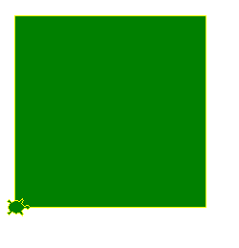
Square with Colours
import turtle
pen = turtle.Turtle()
pen.shape("turtle")
pen.color("yellow")
pen.fillcolor("green")
pen.begin_fill()
pen.forward(100)
pen.right(90)
pen.forward(100)
pen.right(90)
pen.forward(100)
pen.right(90)
pen.forward(100)
pen.right(90)
pen.end_fill()

Slide 31
Activity: Colour the Shapes
Modify the SQUARE program to draw the square with red lines and fill it in green.
Modify the RECTANGLE program to draw the rectangle with orange lines and fill it in purple.

Slide 32
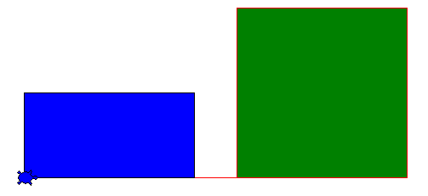
Pen Commands
I want to draw a Square with red line and fill it with green.
I want to draw a Rectangle next to my square with black line and fill it with blue.
When I run the code the resulting graphic has a red line between them.
Why do you think this happens?

Slide 33

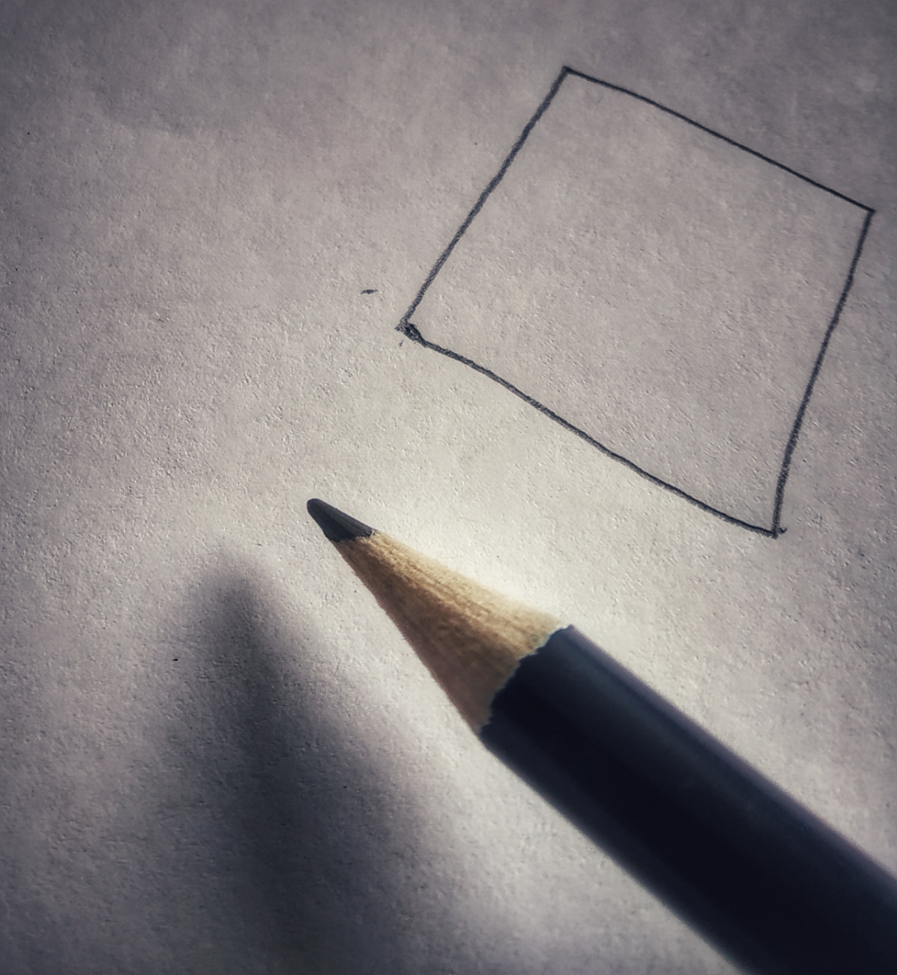
Penup and Pendown
When the turtle is drawing something the pen is down.
If we do not want to draw something then we need to have the pen in the up position.

Slide 34
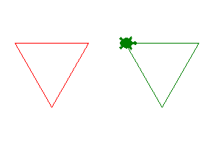
Penup and Pendown
Comments start with #.
Python ignores them.
import turtle
pen = turtle.Turtle()
pen.shape("turtle")
#set the line colour to red
pen.color("red")
#draw the triangle
pen.forward(100)
pen.right(120)
pen.forward(100)
pen.right(120)
pen.forward(100)
pen.right(120)
#lift the pen up
pen.penup()
#move 150 steps forward
pen.forward(150)
#put the pen down
pen.pendown()
#change the line colour to green
pen.color("green")
#draw another triangle
pen.forward(100)
pen.right(120)
pen.forward(100)
pen.right(120)
pen.forward(100)
pen.right(120)

Slide 35
Activity: Pen Exercises
Draw two shapes of your choice (square/rectangle/triangle) next to each other with some space between them.

Slide 36
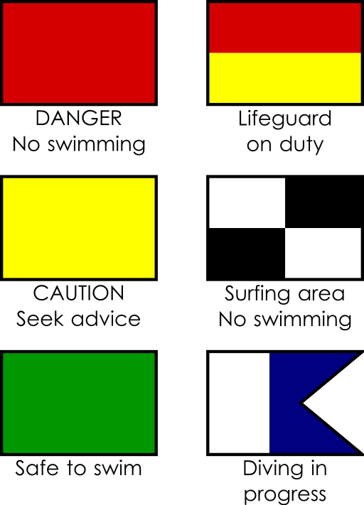
Activity: Fun Flags
Can you draw one or more of these lifeguard flags or a flag of the world using Turtle Graphics?

Slide 37
So Far…
Python is a programming language.
Turtle Graphics is a library in Python used for graphics.
Simple commands like forward(), backward(), left(), right() etc are used to create shapes.
Commands like penup(), pendown(), fillcolor(), color(), begin_fill(), end_fill() etc are used to fill the shapes with amazing colours.

Slide 38
Repeating Instructions
import turtle
pen = turtle.Turtle()
pen.shape("turtle")
pen.color("green")
pen.forward(100)
pen.right(90)
pen.forward(100)
pen.right(90)
pen.forward(100)
pen.right(90)
pen.forward(100)
pen.right(90)
Let us review our first SQUARE program again.
There are some commands which are repeated more than once.
For example, the lines in green are repeated 4 times.

Slide 39
For Loops
A For Loop is a statement in Python that allows you to repeat a set of commands (or instructions).
import turtle
pen = turtle.Turtle()
pen.shape("turtle")
pen.color("green")
pen.forward(100)
pen.right(90)
pen.forward(100)
pen.right(90)
pen.forward(100)
pen.right(90)
pen.forward(100)
pen.right(90)
import turtle
pen = turtle.Turtle()
pen.shape("turtle")
pen.color("green")
for i in range(4):
pen.forward(100)
pen.right(90)

Slide 40
Dissecting the Loop
Let us try and understand the loop a little bit better:
for i in range(4):
pen.forward(100)
pen.right(90)
i | Loop variable | A counter to keep track of the number of times the loop body is run.
range(4) | Range | The number of times the loop body has to be repeated.
pen.forward(100) pen.right(90) | Loop Body | The commands to be repeated.

Slide 41
Indentation in Loops
It is important to indent the code for loops.
Indentation is used to tell Python that the code belongs to the loop.
It helps the code look neat and clean.
It also makes it more readable.
import turtle
pen = turtle.Turtle()
pen.shape("turtle")
pen.color("green")
for i in range(4):
pen.forward(100)
pen.right(90)

Slide 42
Activity: Let’s Loop
You are given a couple of programs where the commands are repeated.
Can you change those programs to use loops and identify the shapes?
Don’t forget the indentation.
Notes:
Program 1:
import turtle
pen = turtle.Turtle()
pen.shape("turtle")
wn = turtle.Screen()
#set the line colour to green
pen.color("green")
pen.forward(100)
pen.right(72)
pen.forward(100)
pen.right(72)
pen.forward(100)
pen.right(72)
pen.forward(100)
pen.right(72)
pen.forward(100)
pen.right(72)
Program 2:
import turtle
pen = turtle.Turtle()
pen.shape("turtle")
wn = turtle.Screen()
#set the line colour to green
pen.color("green")
pen.forward(100)
pen.right(60)
pen.forward(100)
pen.right(60)
pen.forward(100)
pen.right(60)
pen.forward(100)
pen.right(60)
pen.forward(100)
pen.right(60)
pen.forward(100)
pen.right(60)

Slide 43
Python Maths

Slide 44
Recap
Turtle pen up/down
Turtle colours
Loops
  Indentation

Slide 45
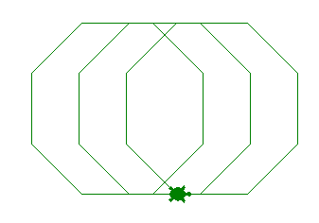
The Three Octagons
We can combine the Pen commands (penup() and pendown()) to produce some very cool graphics.
#Three Octagons
import turtle
pen = turtle.Turtle()
pen.shape("turtle")
pen.color("green")
#draw the first octagon
for i in range(8):
pen.forward(75)
pen.left(360/8)
#lift the pen up
pen.penup()
#move to a different
#location
pen.forward(50)
#put the pen down
pen.pendown()
#draw the second octagon
for i in range(8):
pen.forward(75)
pen.left(360/8)
#lift the pen up
pen.penup()
#move to a different
# location
pen.forward(50)
#put the pen down
pen.pendown()
#draw the third octagon
for i in range(8):
pen.forward(75)
pen.left(360/8)

Slide 46
Activity: Loopy Designs
Use the loops and pen commands to create some funky designs.

Slide 47
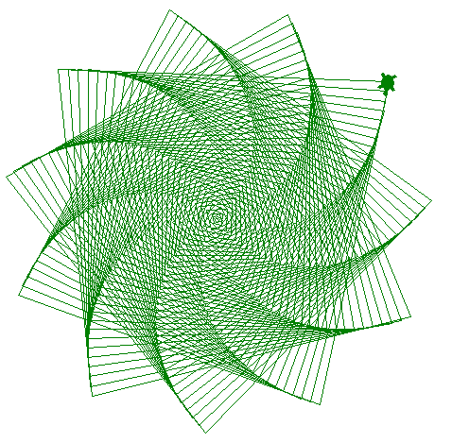
Loop it with a Variable
import turtle
pen = turtle.Turtle()
pen.shape("turtle")
pen.color("green")
for i in range(350):
pen.forward( i )
pen.right(98)
We can also use the loop variable ( i ) inside the design. The code on the left will produce the design below.
Remember, the loop variable is a counter

Slide 48
Extension Activity: Loop it with a Variable

Slide 49
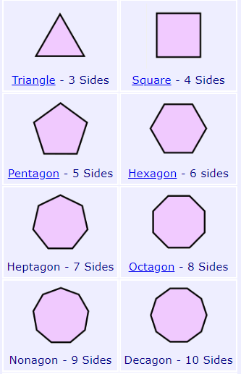
2D Shapes
Let us revise our 2D shapes
We know from the picture that they all have a different number of sides
What are the types of angles associated with 2D shapes?

Slide 50
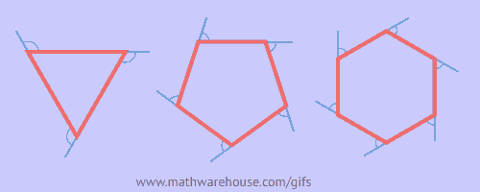
Exterior Angles
Exterior angles are outside the polygon made by extending one of the sides.
Sum of all exterior angles = 360º
Why? If we keep moving around the polygon, extending the sides and measuring each exterior angle, we end up having a circle, which contains 360º.

Slide 51

Size of Each Exterior Angle
All interior angles are equal for regular polygons, hence all exterior angles are equal too.
To work out the size of each exterior angle we use the formula:
360$÷$number of sides

Slide 52
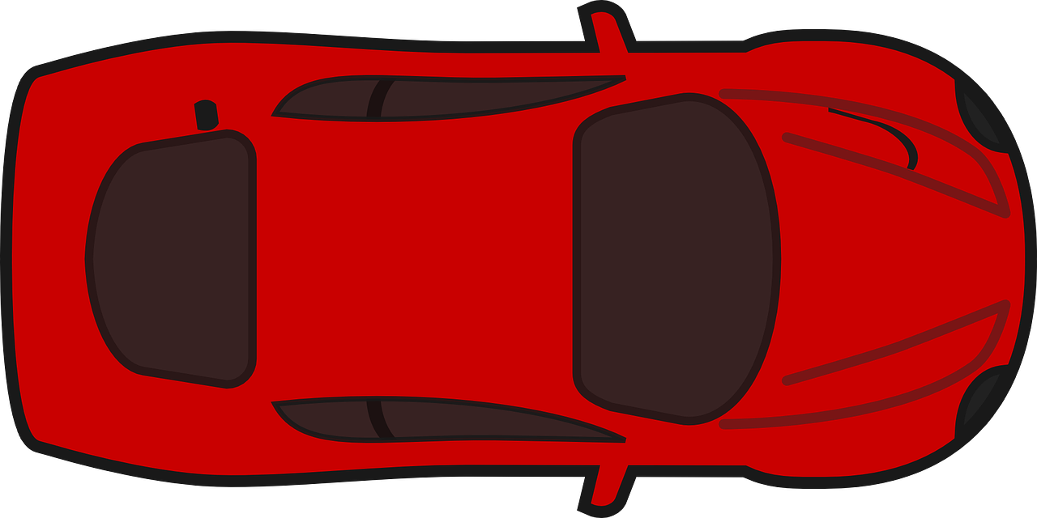

Applying Exterior Angle
In the whole motion we made 1 full rotation, turning 4 times. The angle for each turn is
$\frac{360°}{4}=90°$

Slide 53
Activity: Angles
Complete the table in your workbooks by filling in the number of sides, total sum of exterior angles and size of each exterior angle for the given regular polygons.

Slide 54
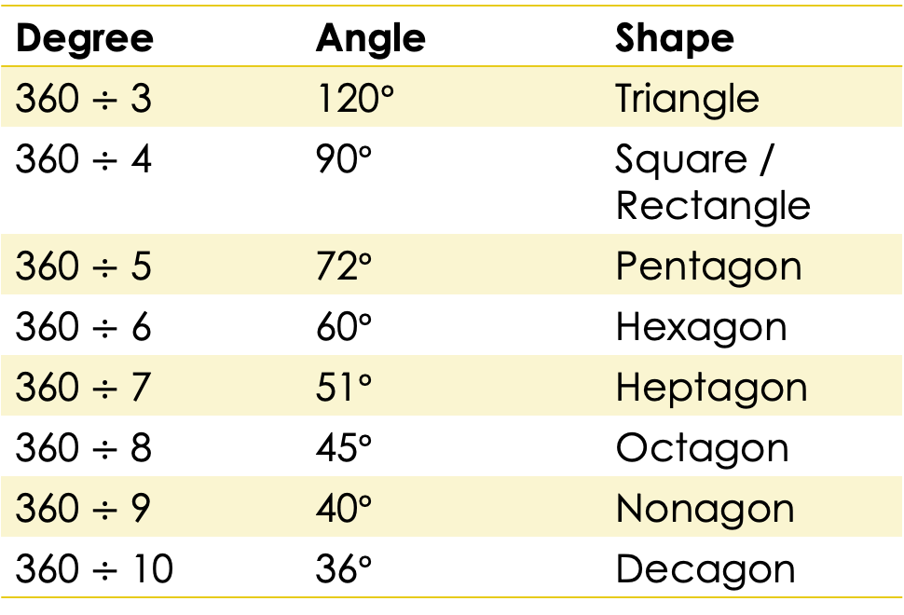

Angle Facts
We can calculate the exterior angle of any polygon using the formula: 360$÷$ number of sides
Degree | Angle | Shape
360 $÷$ 3 | 120$°$ | Triangle
360 $÷$ 4 | 90$°$ | Square / Rectangle
360 $÷$ 5 | 72$°$ | Pentagon
360 $÷$ 6 | 60$°$ | Hexagon
360 $÷$ 7 | 51$°$ | Heptagon
360 $÷$ 8 | 45$°$ | Octagon
360 $÷$ 9 | 40$°$ | Nonagon
360 $÷$ 10 | 36$°$ | Decagon
Can we rewrite the Turtle Program to create all these 2D shapes based on their number of sides?

Slide 55

Automate the Angles
We need to ask the user the number of sides the shape they want to draw has.
We then store their answer in a variable.
Use that variable in the calculation of our exterior angle formula in the loop body.
And also in the range part of the Loop.
import turtle
pen = turtle.Turtle()
pen.shape("turtle")
sides = int(input("how many sides do you want?"))
pen.pendown()
for i in range(sides):
pen.forward(100)
pen.left(360/sides)
360$÷$sides

Slide 56
Input and Variables
sides = int(input("how many sides do you want? "))
sides | The variable that will store the answer. Variable is a name that stores the value of something.
input | The command that will ask the user the question. The value will always be text.
int | The command to change from text to a number.
how many sides do you want? | The question you want to ask the user.

Slide 57
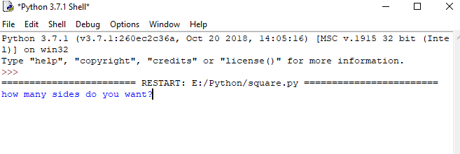
How Does it Work?
When you run the code, it will prompt you on the screen to enter the number of sides.

Slide 58
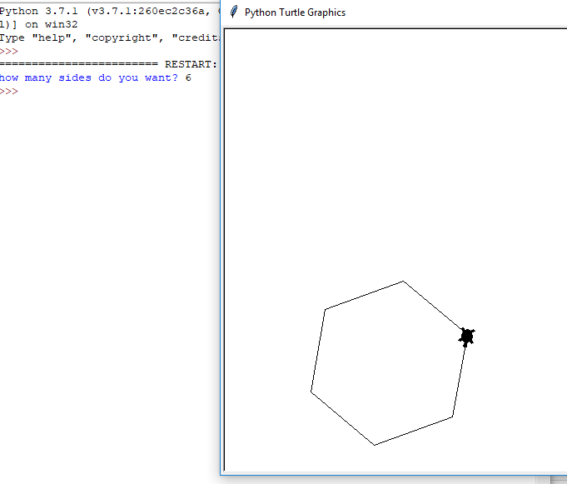
Result
Once the number of sides is entered, the Turtle draws the shape for you.

Slide 59
Activity: Draw Any Shape
The code is given to you, but it is not arranged in the correct order.
Based on what we have learned, rearrange the code to make it work.
Notes:
Correct answer:
import turtle
pen = turtle.Turtle()
pen.shape("turtle")
sides = int(input("how many sides do you want?"))
pen.penup()
pen.backward(10)
pen.right(100)
pen.forward(100)
pen.pendown()
for i in range(sides):
pen.forward(100)
pen.right(360/sides)

Slide 60
Extension Activity: Colour the Shape
Ask the user which colour they would like to use to fill their shape.
Store that in a variable called userColour.
Use the variable in fillcolor() command.

Slide 61
Conditionals
If it is raining outside, then take the umbrella.
If homework is completed then go and play Xbox, else sit and complete it.
These are some real-life situations where we use conditions.
We take some action if the condition is true (e.g. play Xbox), and another action if the condition is false (e.g. complete the homework).
Condition
True
False
There are only two outcome: True or False
True Action
False Action

Slide 62
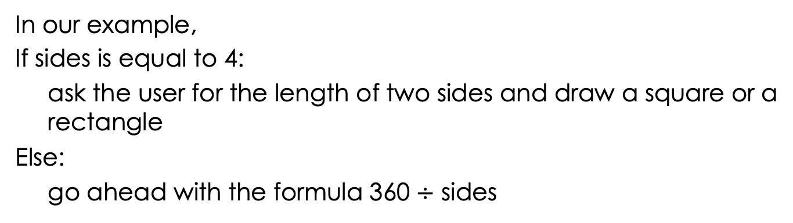
Python Conditionals
Remember the indentations
if (condition):
then do these things
else:
do these things
In our example,
If sides is equal to 4:
ask the user for the length of two sides and draw a square or a rectangle
Else:
go ahead with the formula 360 $÷$ sides

Slide 63
Conditionals
if (sides == 4): | Conditional Statement. Note the : (colon) at the end and the == (equal to) sign to check if the variable “sides” is equal to 4.
side1 = int(input("What is the length of side 1? ")) side2 = int(input("What is the length of side 2? ")) ……. | Code that is executed if the condition is true. In other words, if the sides value is 4 then these lines of code will be run.
else: | Conditional else. Note the : (colon) at the end.
for i in range(sides): pen.forward(100) pen.left(360/sides) | If the sides value is not equal to 4 then these lines of code will be run.

Slide 64
Using Conditionals
import turtle
pen = turtle.Turtle()
pen.shape("turtle")
sides = int(input("how many sides do you want? "))
pen.pendown()
if (sides == 4):
side1 = int(input("What is the length of side 1? "))
side2 = int(input("What is the length of side 2? "))
for i in range(2):
pen.forward(side1)
pen.left(90)
pen.forward(side2)
pen.left(90)
else:
for i in range(sides):
pen.forward(100)
pen.left(360/sides)
What would happen
if side1 & side2 = 100
What would happen if side1 = 100 and
side2 = 200?

Slide 65
Activity: Conditional Shapes
Reorder the automated shape program and complete the conditions we have just discussed.

Slide 66
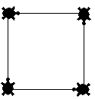
Stamp
import turtle
pen = turtle.Turtle()
pen.shape("turtle")
for i in range(4):
pen.forward(100)
pen.right(90)
pen.stamp()
In our earlier scenarios, the turtles move from one location to another.
Stamping is the process of making an impression of the turtle on the screen.
This works even if the pen is up.

Slide 67
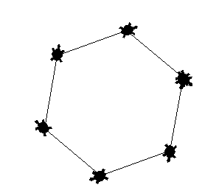
Activity: Stamp the Turtles
Using the commands create random shapes and stamp the turtle on the screen for every shape.

Slide 68
Activity: Turtle Review

